Slide 1

Submitted by- Arpit Saxena
Manjari Johri
Lokendra Muni
Poonam Yadav
Submitted to- Mr. Shivendra Sir

Slide 2
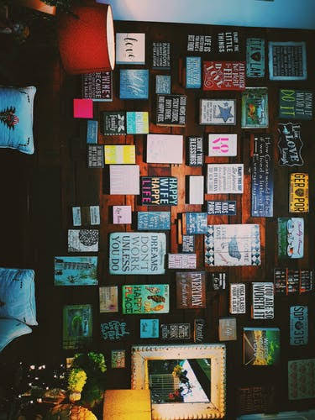
Presentation on online food ordering

Slide 3
Contents
Project Introduction
Hardware and Software Requirement
Website View & Coding
Business Model & SWO
Core Competency
Future Aspects
References

Slide 4
Project introduction
Genuine Name- FOOD HUNGER
Slogan- “Discover great places to eat around you.”
Positioning- FOOD HUNGER provides the ”guide” or
the “discovery” experience of
restaurants & food guide.
Category- Website Platform
Sector- Food & Restaurant Guide

Slide 5
HARDWARE & SOFTWARE REQUIREMENTS
*Hardware*
Computer- OS Windows 10, Mac, Disk Space, Web Browser
Smartphone- Android, OS ,Web Browser
*Software*
Brackets-text editor
Google ( chrome, UC browser )
Scripting Languages– HTML -5 , CSS-3, BOOTSTRAP .

Slide 6
Website view

Slide 7
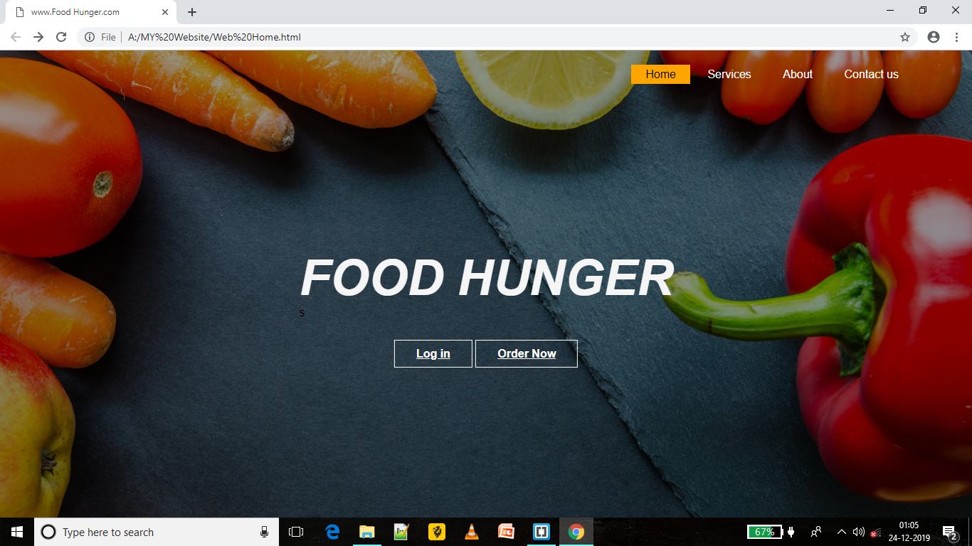
home page

Slide 8
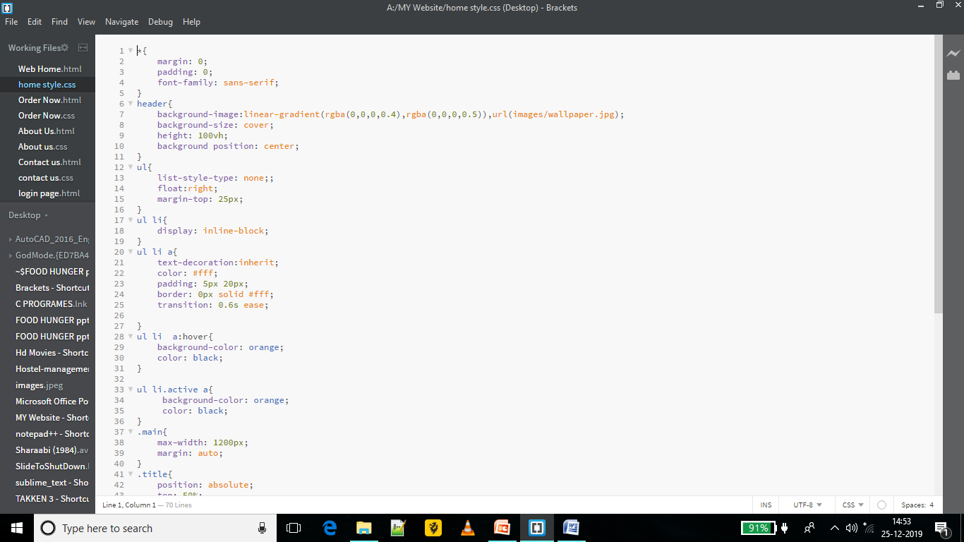
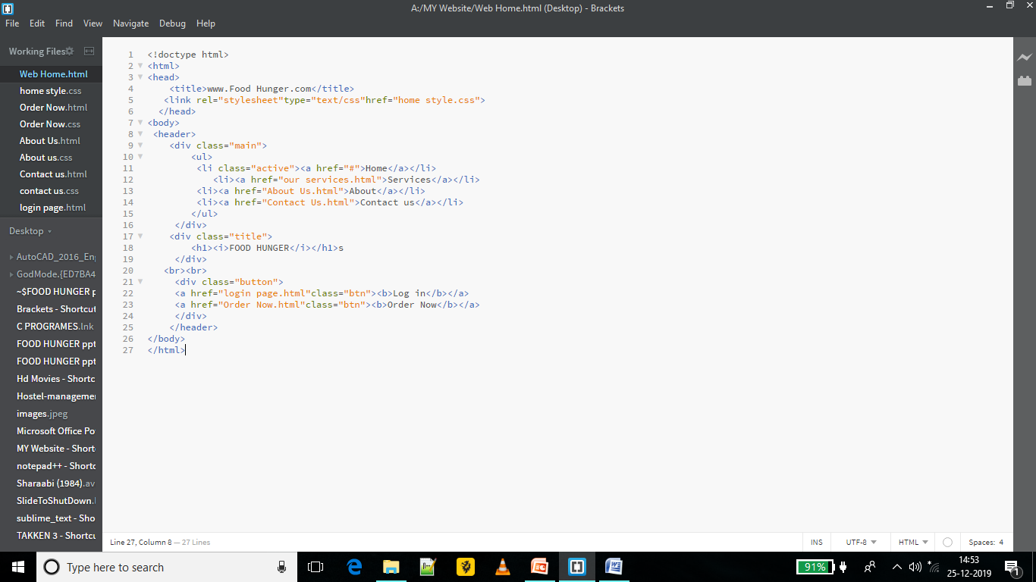
home PAGE CODING

Slide 9
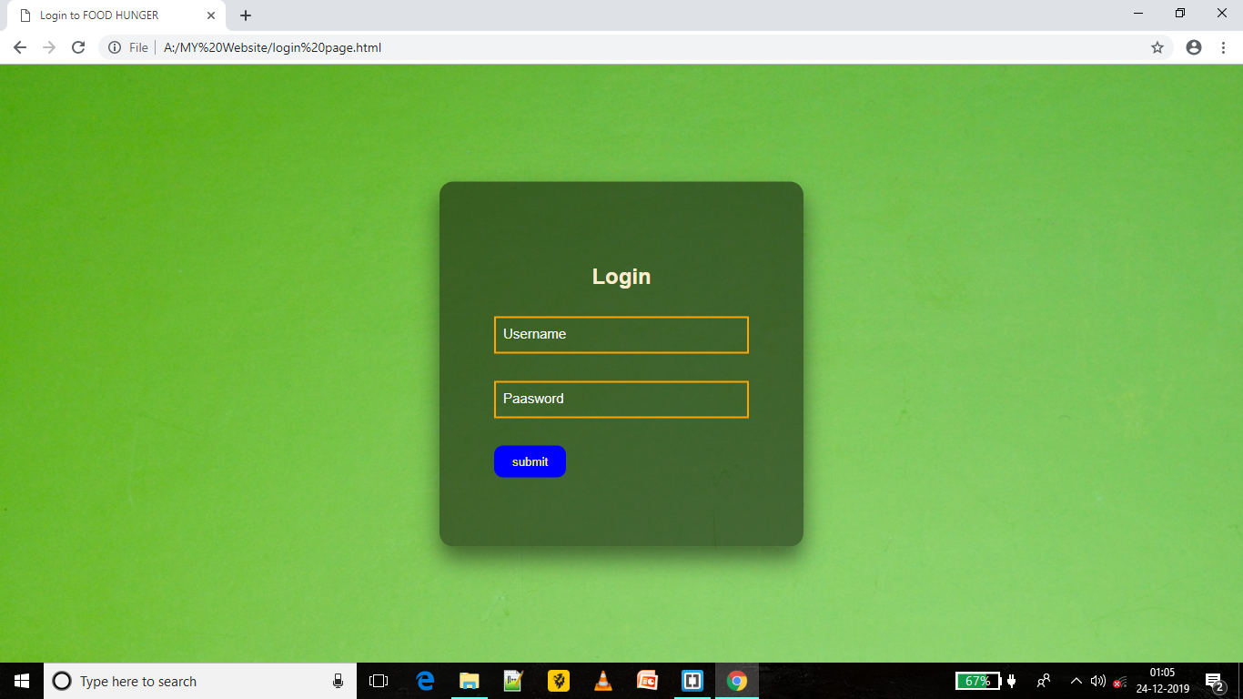
Log-in Page

Slide 10
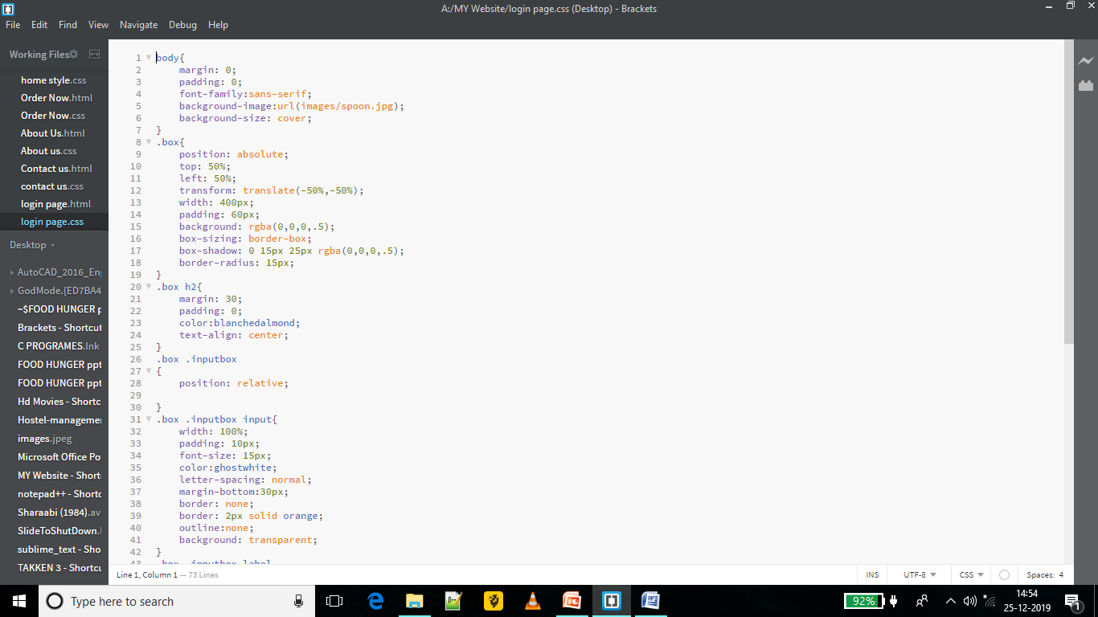
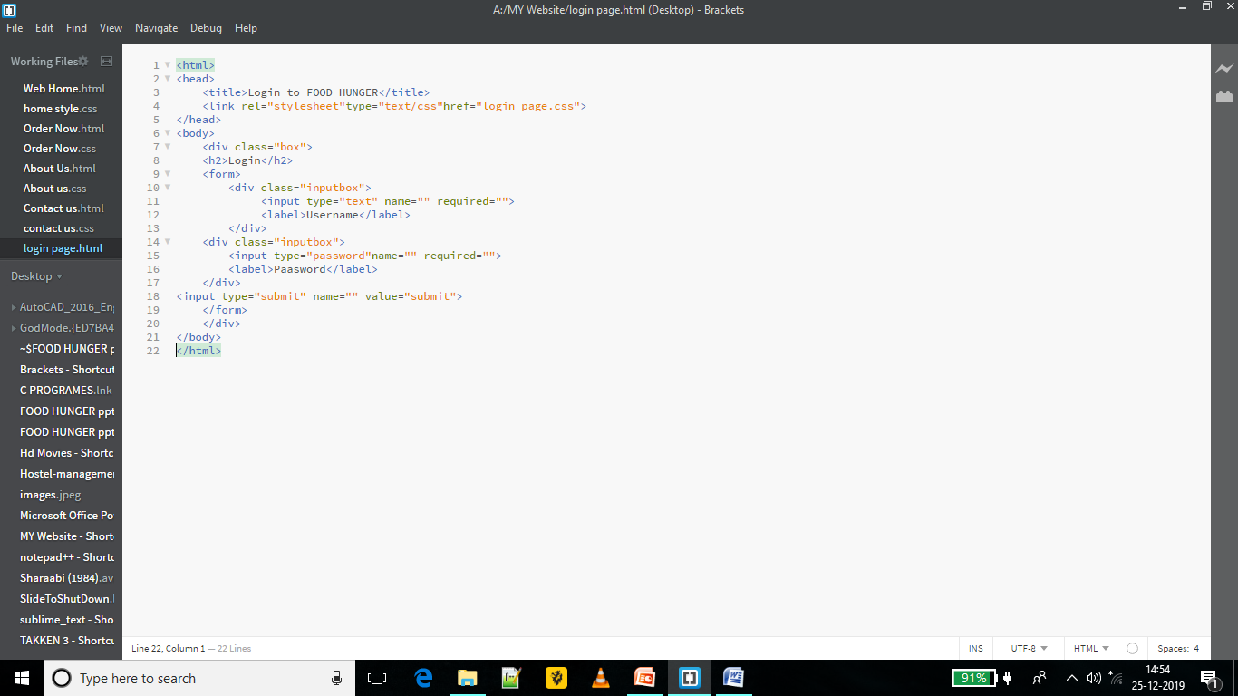
Log in page coding

Slide 11
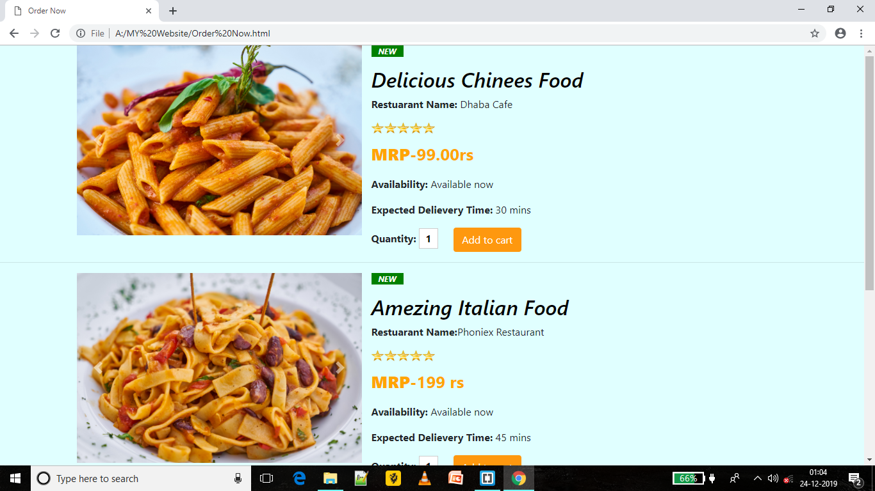
ORDER-NOW PAGE

Slide 12
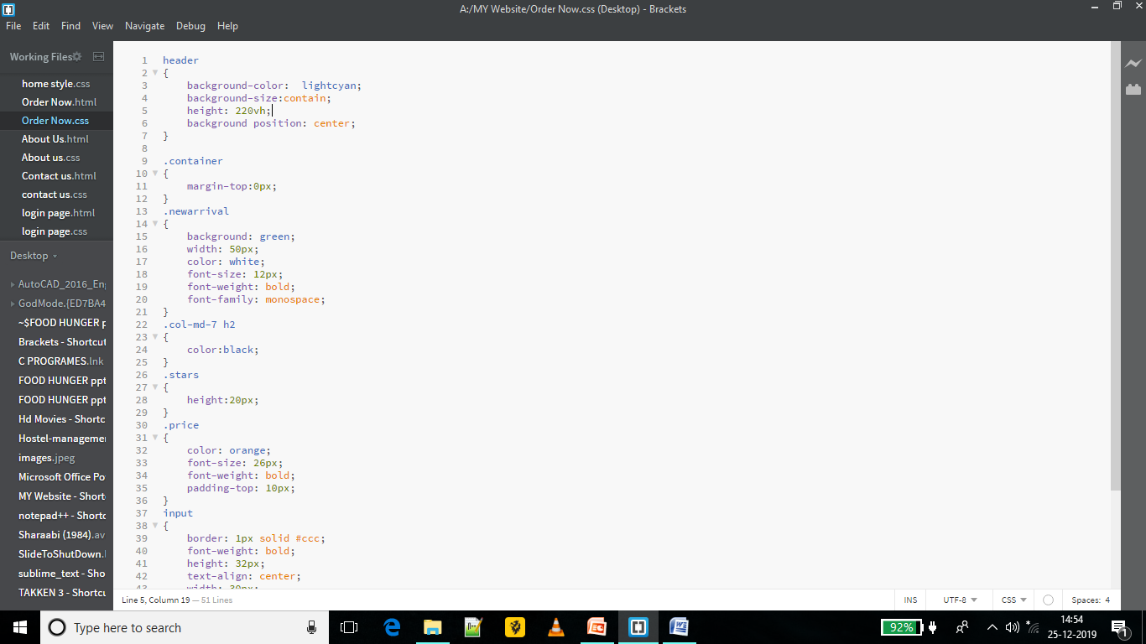
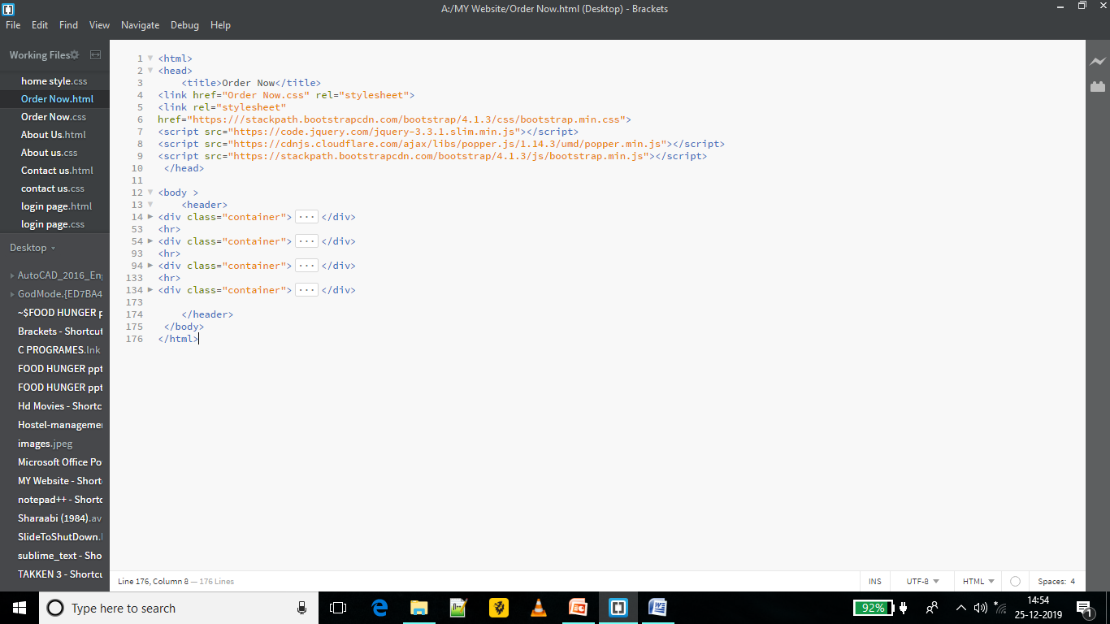
Order now coding

Slide 13
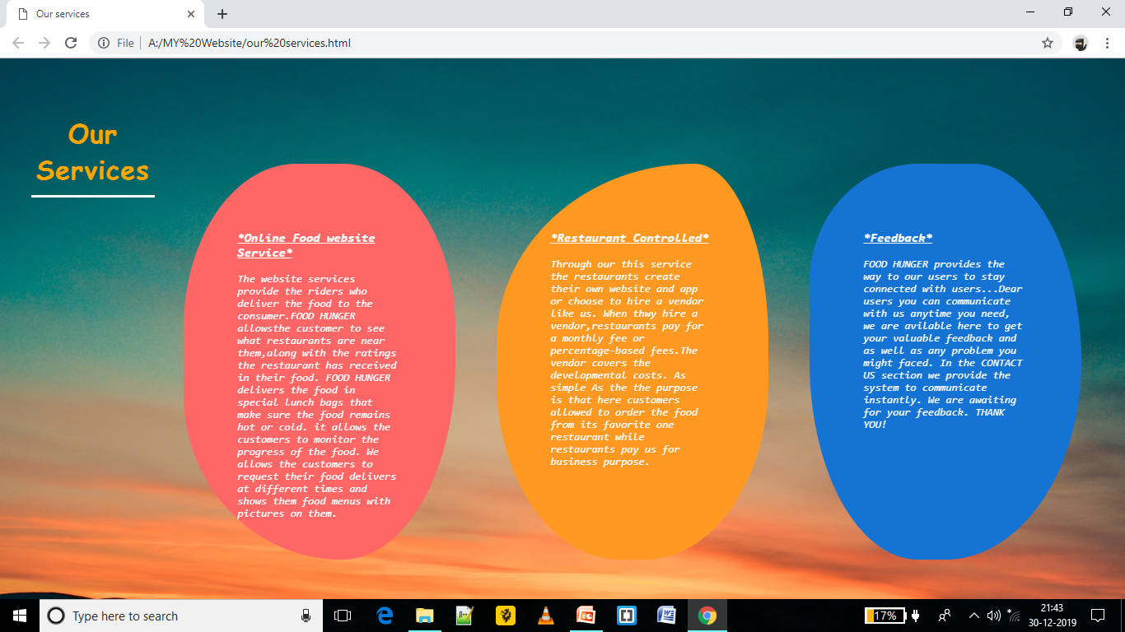
Our services page

Slide 14
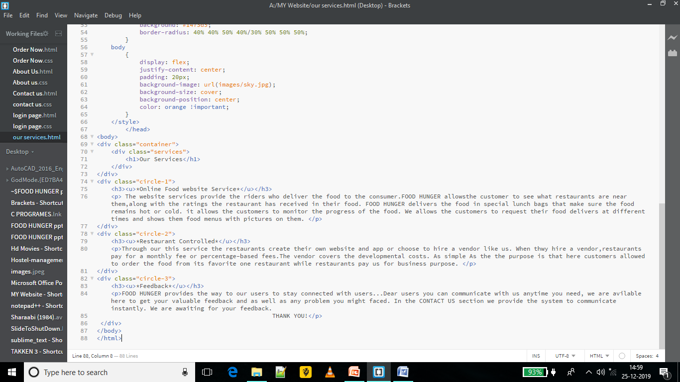
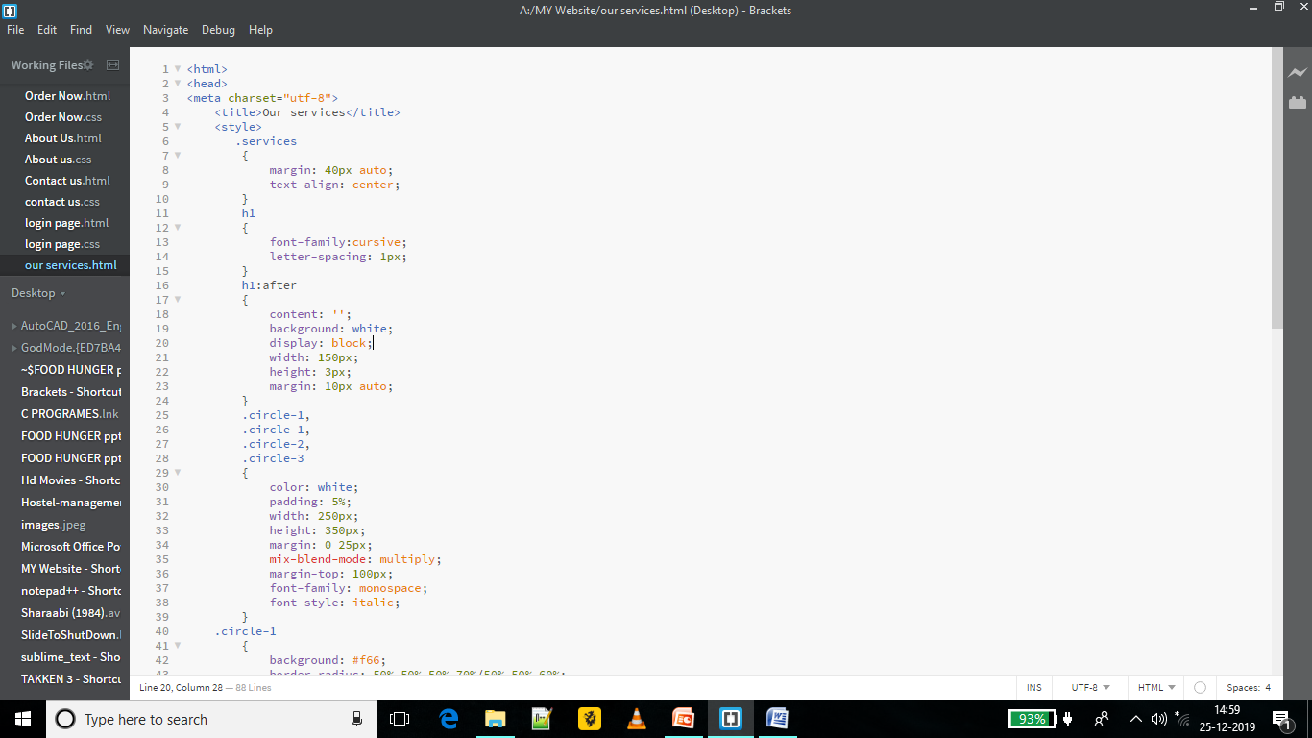
Our services coding

Slide 15
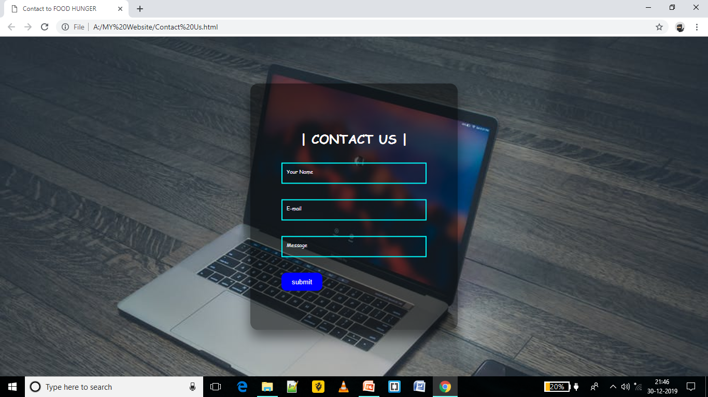
Contact us page

Slide 16

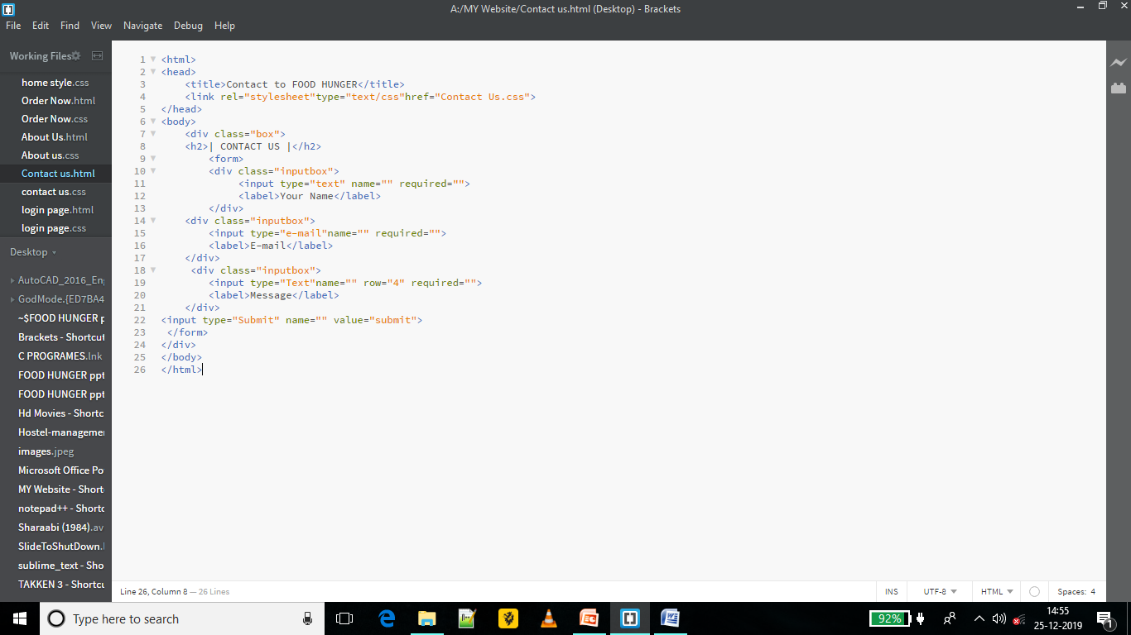
Contact us coding

Slide 17
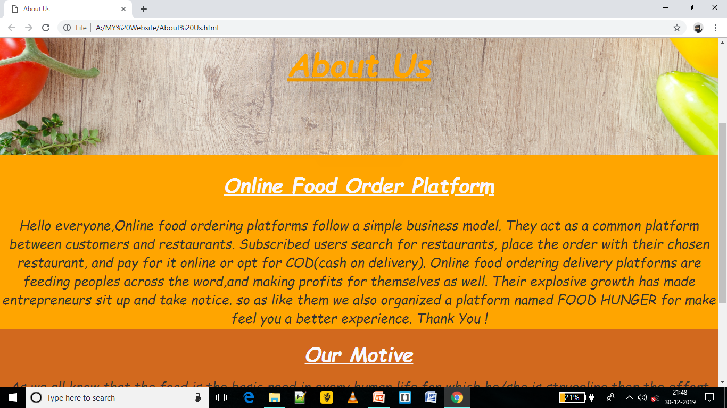
About us page

Slide 18
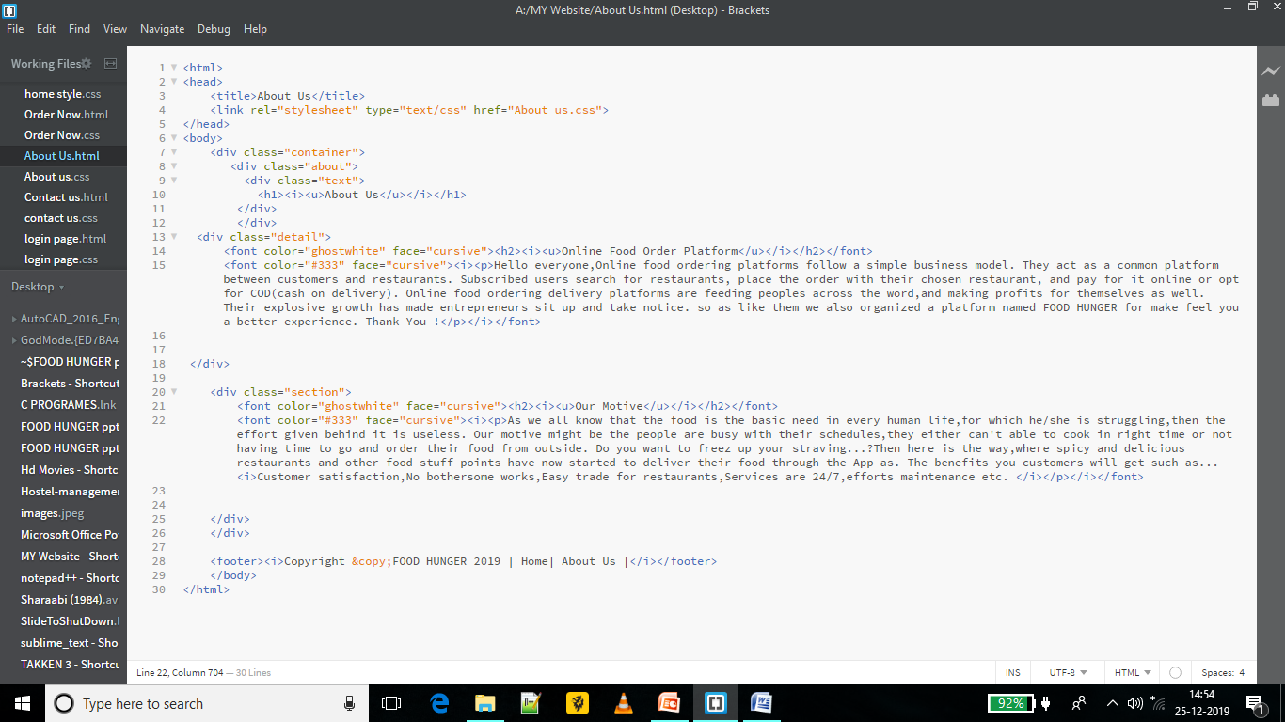
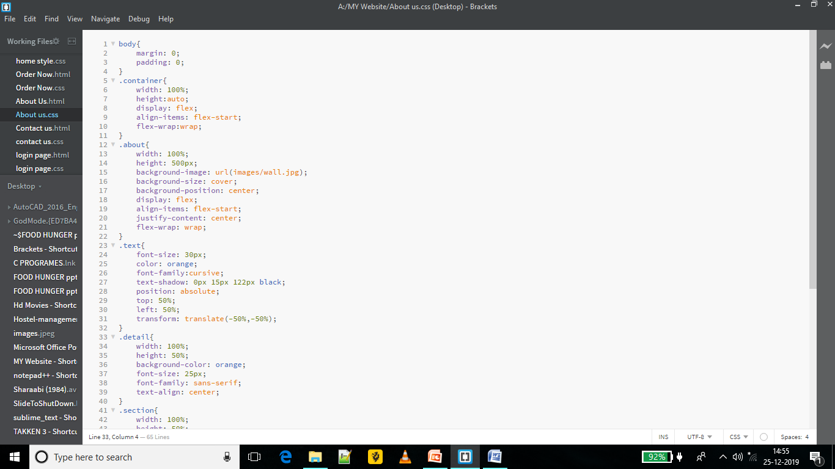
About us coding

Slide 19




BUSINESS MODEL
Restaurant Pays FOOD HUNGER for being featured.
User Views restaurant.
More Customer footfall for the restaurant.
User
Restaurant

Slide 20
STRENGTH
User explore FOOD HUNGER as ‘Speciality product’(Focused only on foods & restaurants)
High Awareness- Top of mind product.
Global Presence-
Superior Technology and a strong workforce of over peoples.
Simple & user friendly interface.
Aggressive and innovative marketing strategy.

Slide 21
Weakness
Competition from search engines & other similar apps means limited growth.
Drastic growth means very sensitive to bad content.
Not customized for each target market.
Work inefficiency.
High staff turnover.

Slide 22
Opportunities
Opportunity to expand to further more countries.
Increasing internet penetration & number of smartphones user.
Rapid technology development.

Slide 23






Core Competency
FOOD HUNGER maintains a strong internal structure to complete their business model.
Key Resources Key Activities
Website Platform Restaurant
Customer Service Field Teams
User & Restaurant Data Analysis
Database

Slide 24
Future aspects
First mover advantage.
Strong Content Platform (SCP).
Efficient Employees.
Good rating mechanism and social platform
Notes:
As these future aspects can be mentioned as Reasons behind Success.

Slide 25
References
Wikipedia.
Quora.
Linkdin Slideshare.
Zomato Blogs.

Slide 26
Thank you !

